Slide 1

Remote Sensing Data Handling using Python
Jaap Langemeijer
Floris Calkoen
Etiënne Kras
Naam Achternaam

Slide 2
Content & Time schedule
Walk-in + introductions 14:00 – 14:15
Data access (STACs & APIs) – Floris 14:15 – 14:45
Where to get data & how to load it in?
Data processing – Etiënne 14:45 – 15:15
How to process data?
Break 15:15 – 15:30
Data visualization – Jaap 15:30 – 16:00
How to visualize data?
Exercise 16:00 – 17:00

Slide 3
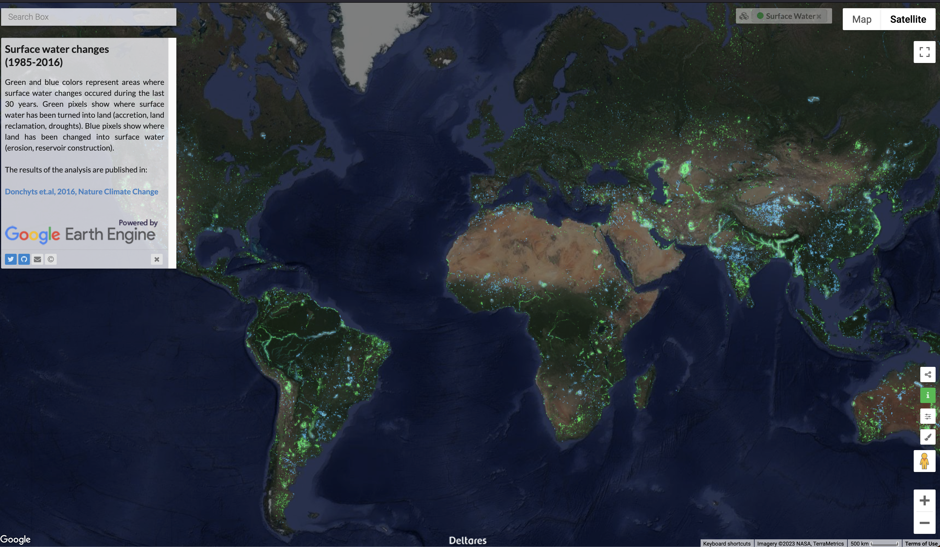
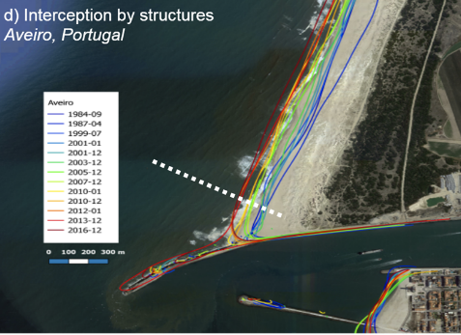
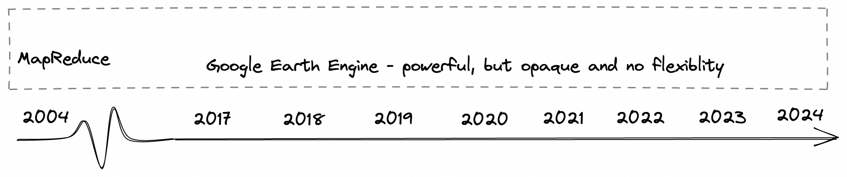
Google Earth Engine revolutionized digital Earth Sciences
Aqua Monitor, Donchyts et al., 2016
ShorelineMonitor, Luijendijk et al., 2018
Notes:
Key message: we are producing more data
Highlight difference everywhere (ShorelineMonitor) vs everywhere (CoastSat) and how this breaks EE workflow

Slide 4
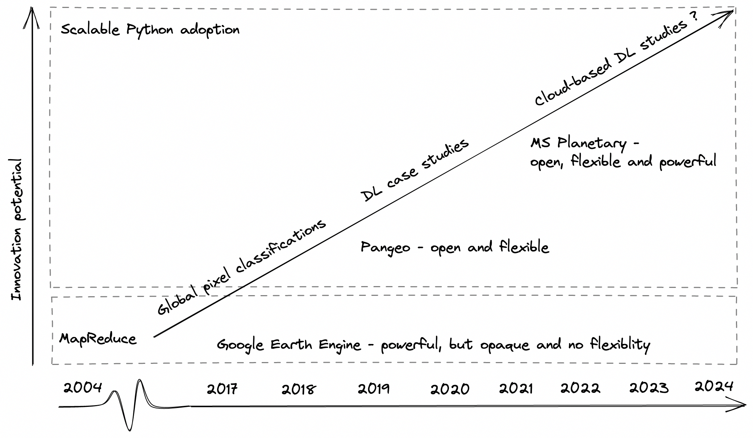



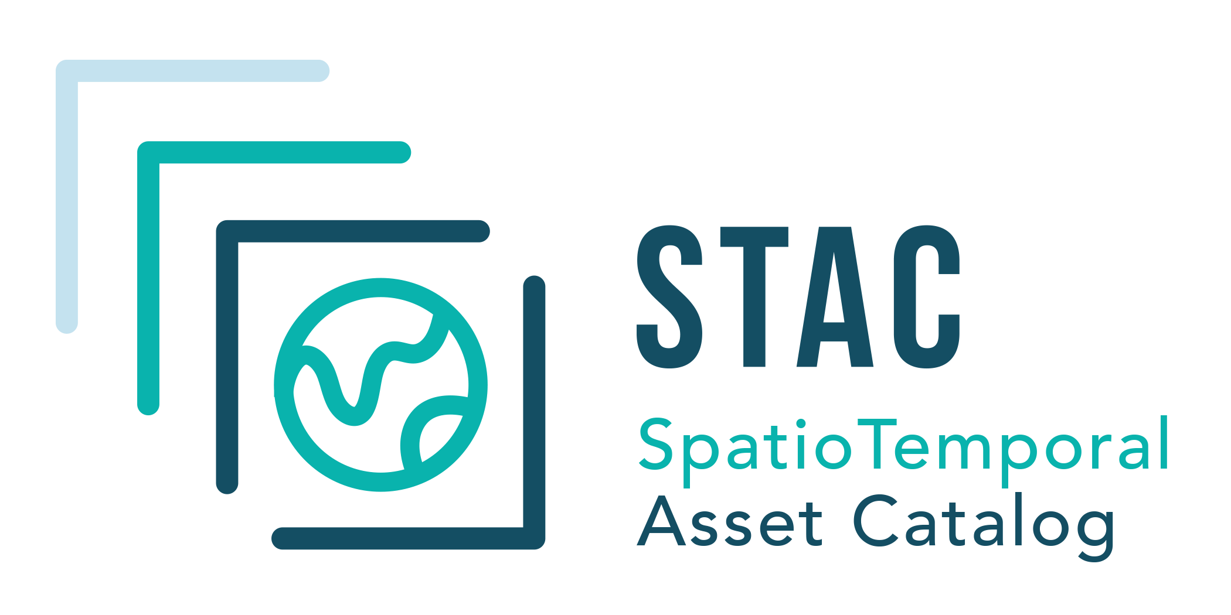

Google Earth Engine vs. the Pangeo approach
EO data are stored in cloud-optimized formats and are accessible using a consistent API
Innovative coastal geoanalytics
Notes:
(Coastal data is not: e.g., ShorelineMonitor data are strings of nested arrays wrapped in a csv)
Pangeo – opendap, rasterman?
Impact to innovation

Slide 5
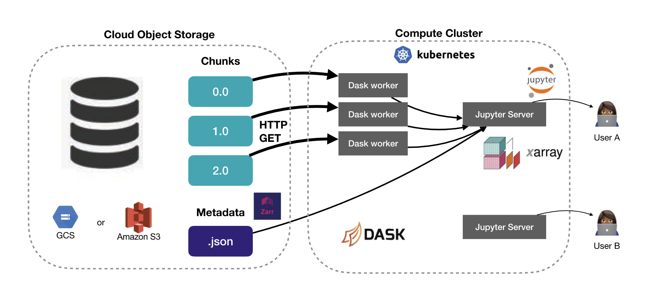
Pangeo approach to big environmental data analysis
Advantages:
Scalability
Accessibility
Flexibility
Transparency
Enable FAIR data & workflows
ARCO EO data
Figure adopted from Abernathy et al., 2021

Slide 6
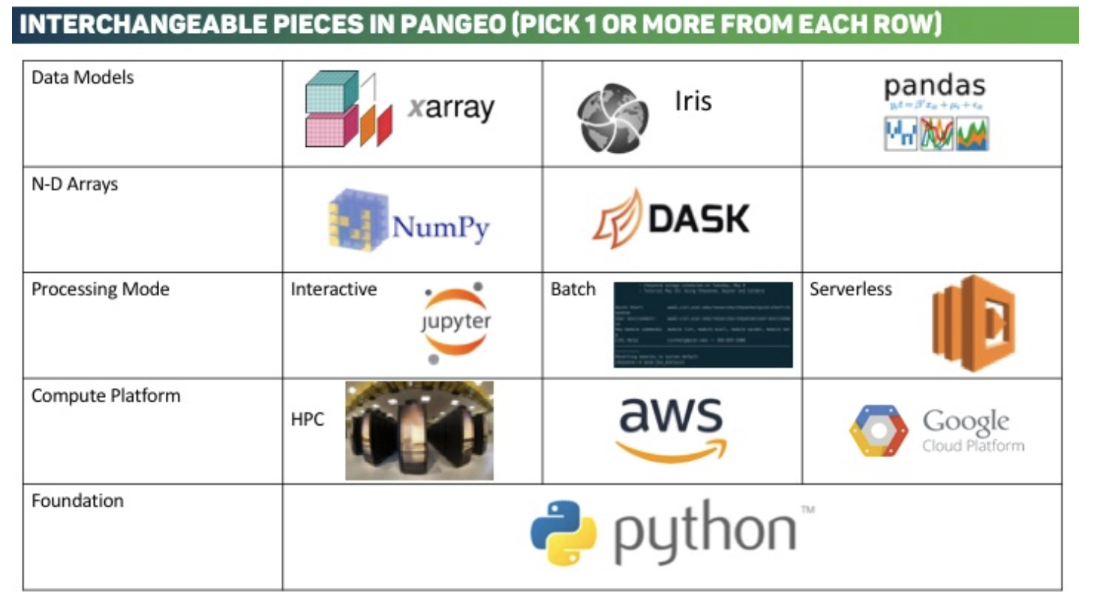
Pangeo software

Slide 7
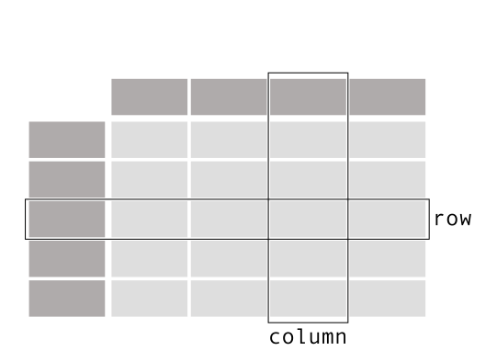
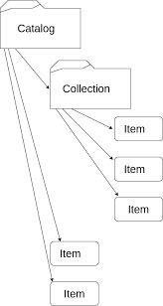
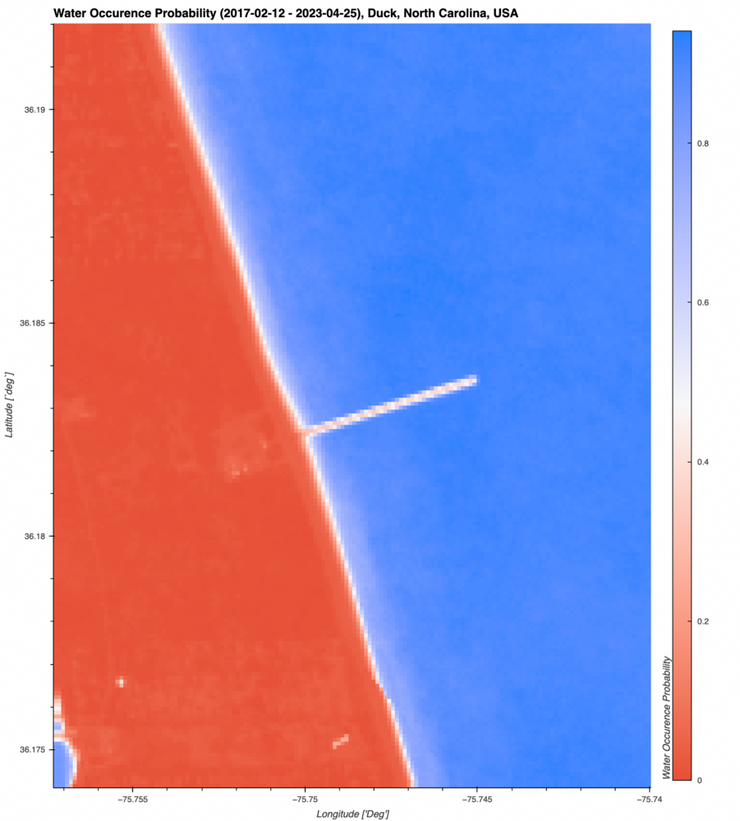

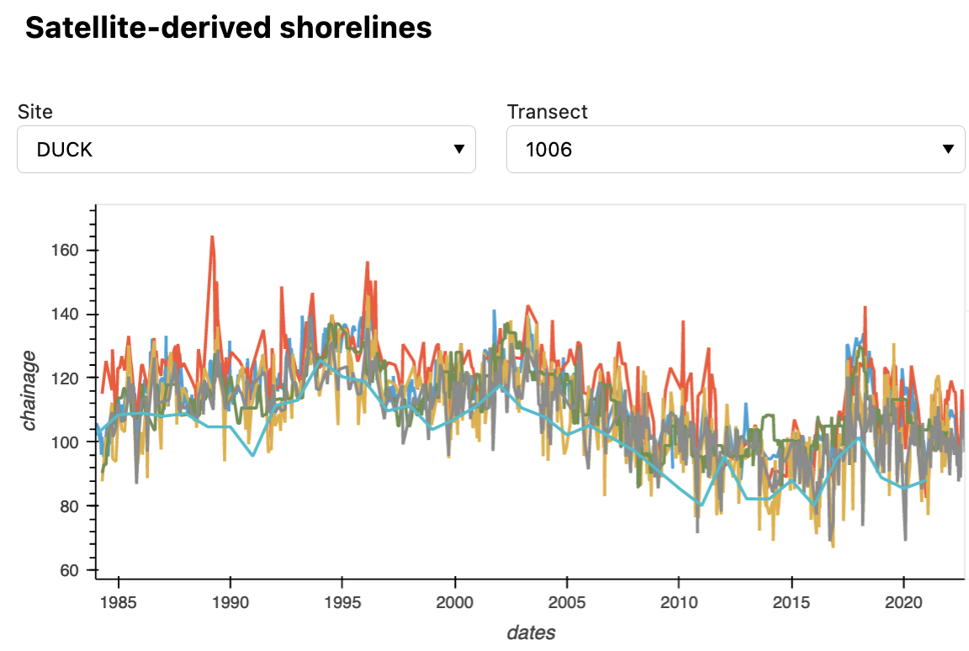
Tabular
Data formats
Metadata
Raster
Scalable & Fast
Stations

Slide 8
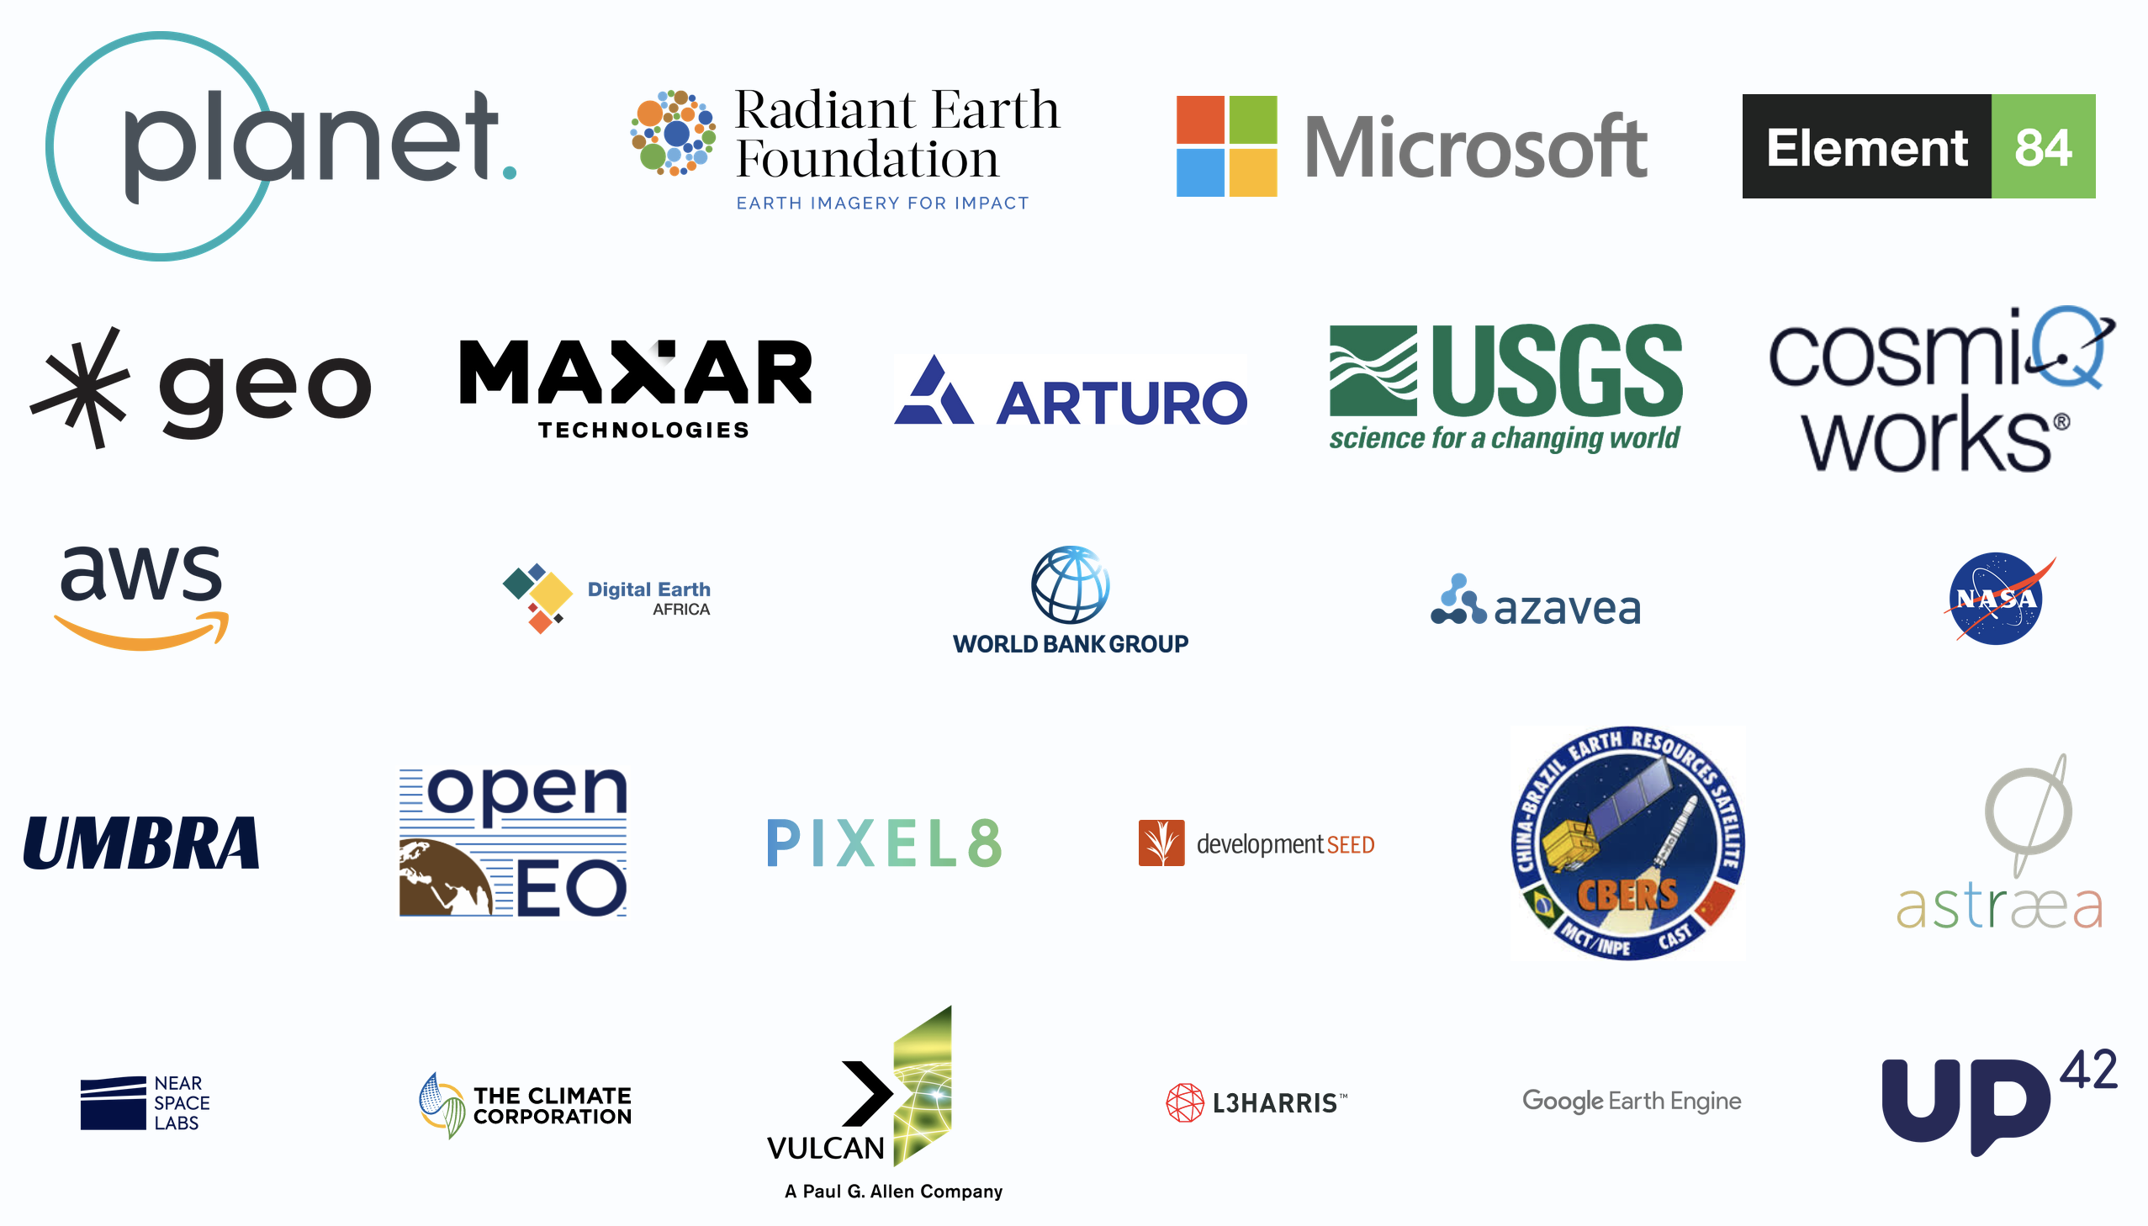
STAC supporters

Slide 9
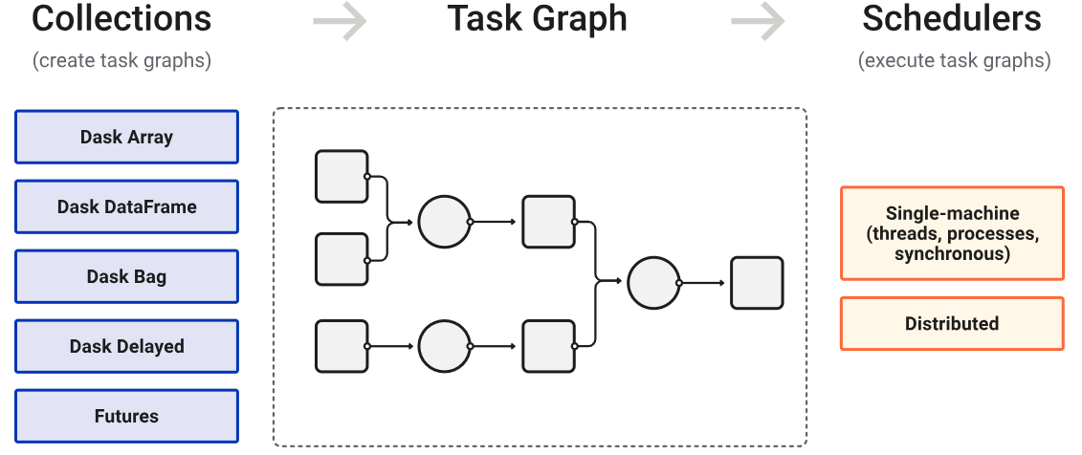
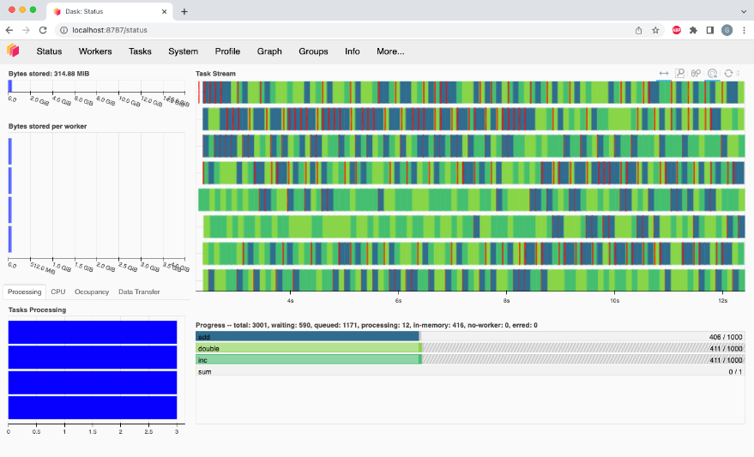
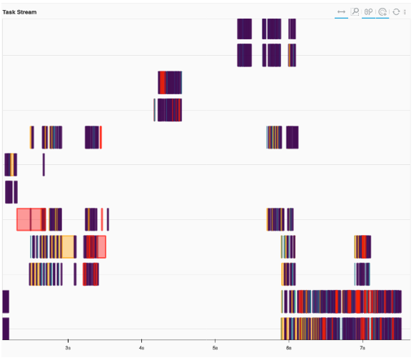
Data processing (1)
Previously, downloading and loading data full datasets into memory…
Now, analysis directly from the STAC datasets
Processing:
Only when triggered by compute() and plot() functions
Dask dashboard (for profiling parallel code)
Cloud computations with a Dask gateway (scalable)
More advanced options
Uploading python files to a dask cluster
Applying customized functions to Xarray datasets
→ Steep learning curve for more complex calculations!

Slide 10
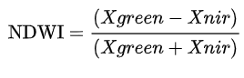
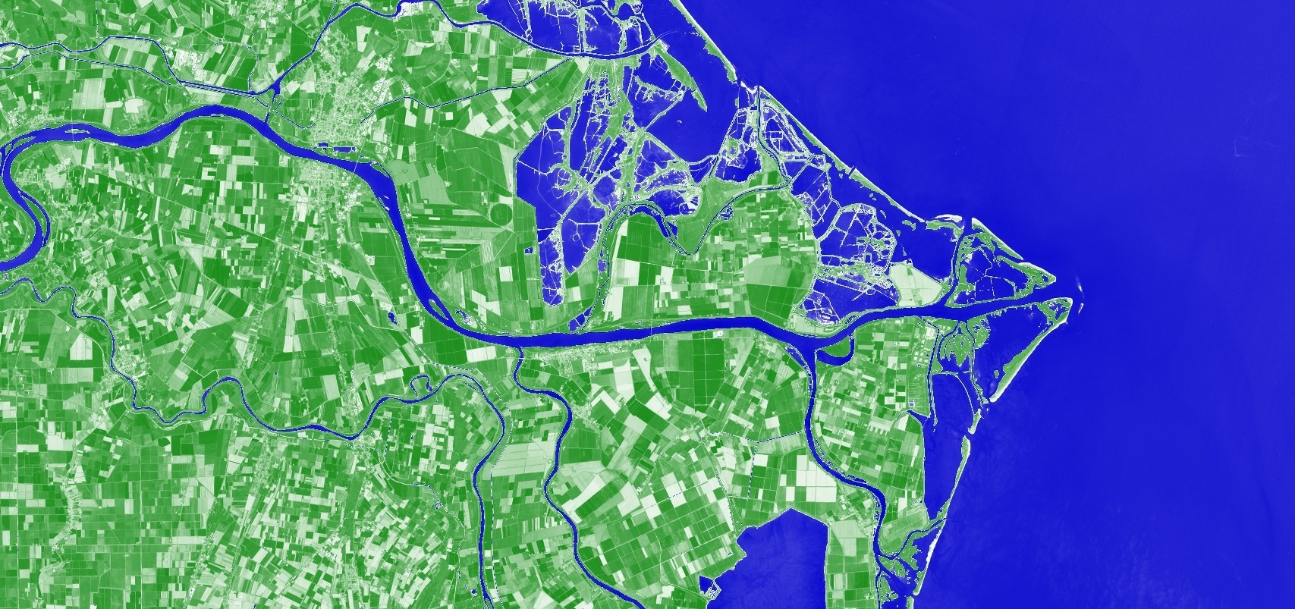
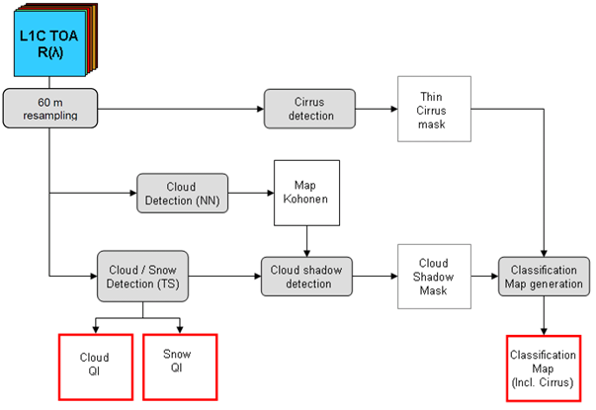
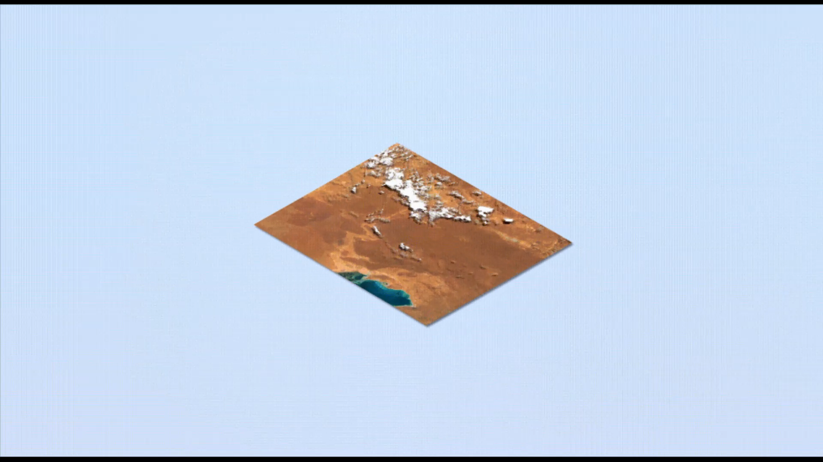
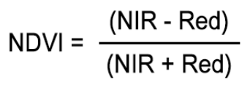
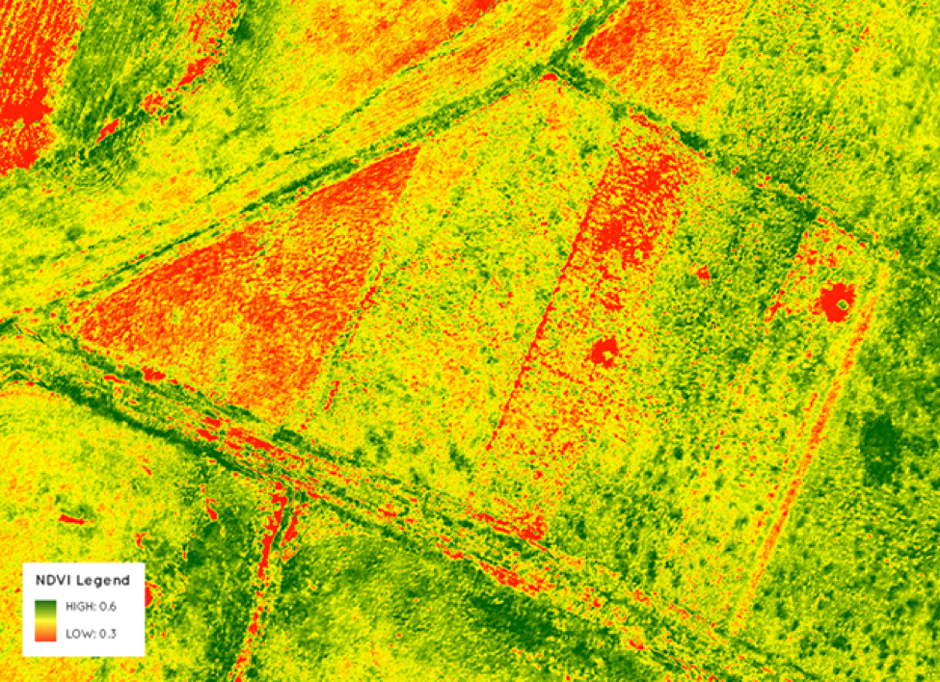
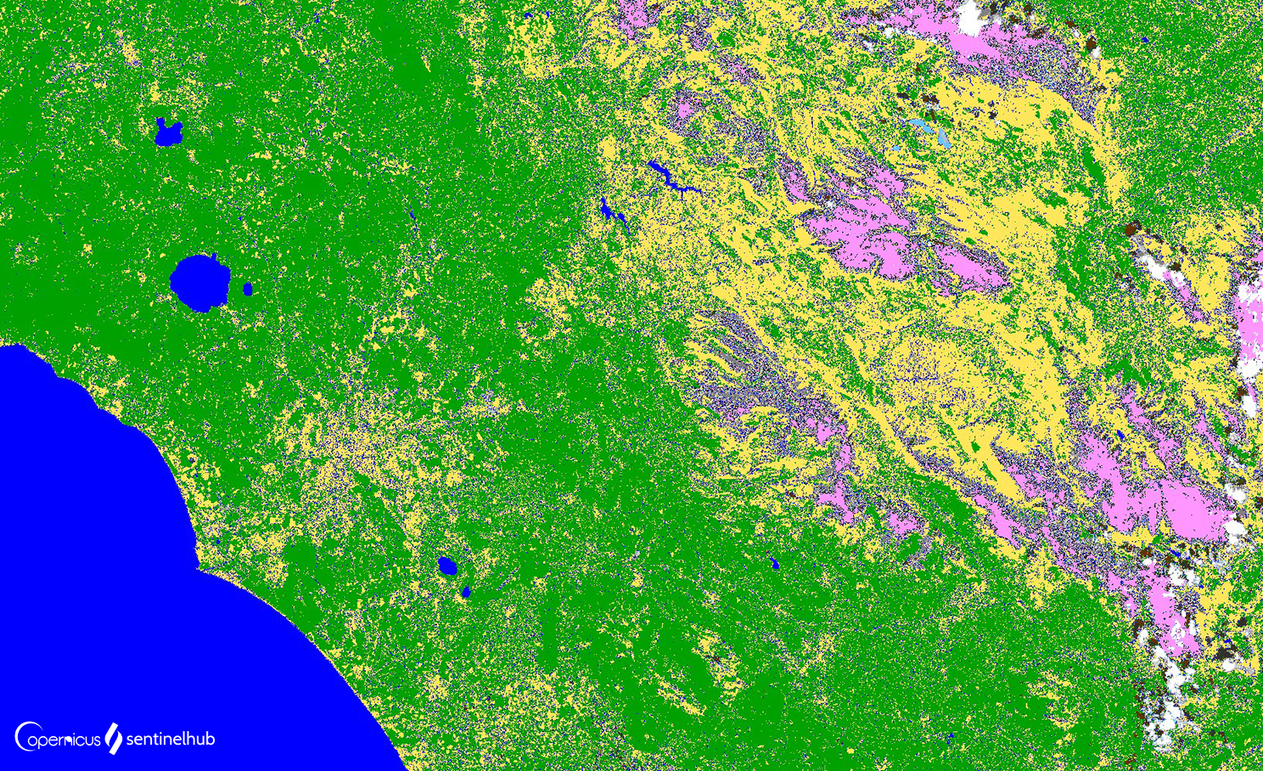
Data processing (2)
Local computations with a Dask cluster, examples:
NDWI
Compositing
Scene classification
NDVI with DEA STAC

Slide 11
Data visualization
Lazy loading
Interactivity
Many technologies available
Holoviz
QGIS
geemap (quick mention)
xarray + matplotlib
Plotly (dash)
ipyleaflet / folium

Slide 12
Holoviz
Ecosystem of plotting tools:
Panel: Assembling objects from many different libraries into a layout or app, whether in a Jupyter notebook or in a standalone servable dashboard
hvPlot: Quickly return interactive HoloViews, GeoViews, or Panel objects from Pandas, Xarray, or other data structures
HoloViews: Declarative objects for instantly visualizable data, building Bokeh plots from convenient high-level specifications
GeoViews: Visualizable geographic data that that can be mixed and matched with HoloViews objects
Datashader: Rasterizing huge datasets quickly as fixed-size images
Lumen: Framework for visual analytics that allows users to build data-driven dashboards from a simple YAML specification
Colorcet: A wide range of perceptually uniform continuous colormaps and perceptually based categorical color sets for use with the other libraries
HoloViz Flow

Slide 13
GeeMap
Python package for (mostly) visualizing Maps and Vectors using the python EE API
Same Map API as the JavaScript (code editor) API
Example!

Slide 14
Key takeaways
Earth Observation works with large volumes of data. Therefore, we need a different way of working when processing and visualizing this data using python.
EarthEngine offer an environment that works as a "black box"
The scalable python (PanGEO) paradigm offers a flexible and scalable alternative:
STAC and xarray helps with finding and parallel loading of data
The Dask ecosystem helps with parallel processing of the data (scaling)
Interactivity and lazy loading for plotting is offered by Holoviz

Slide 15
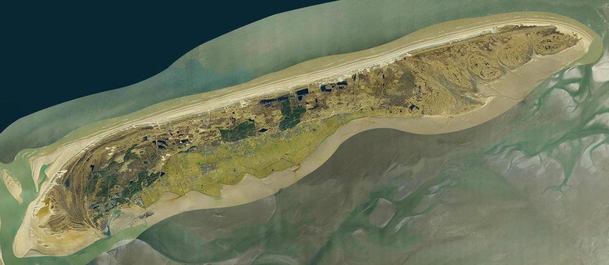
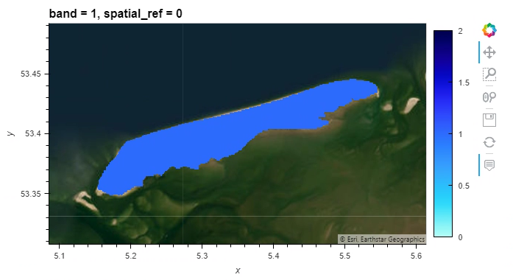
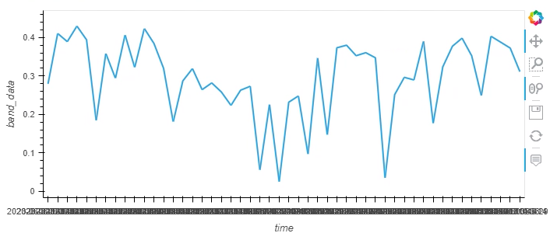
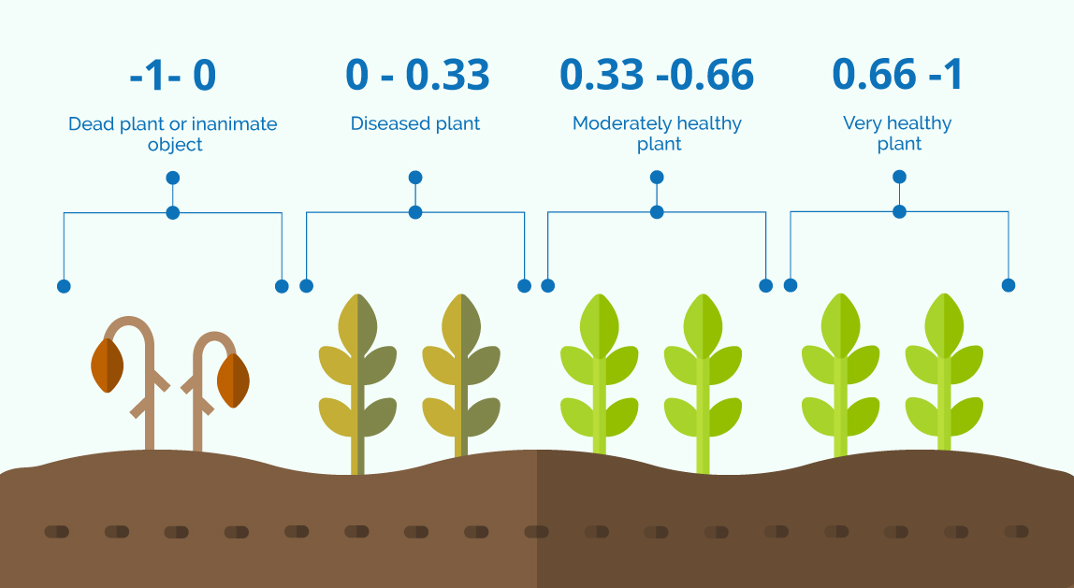
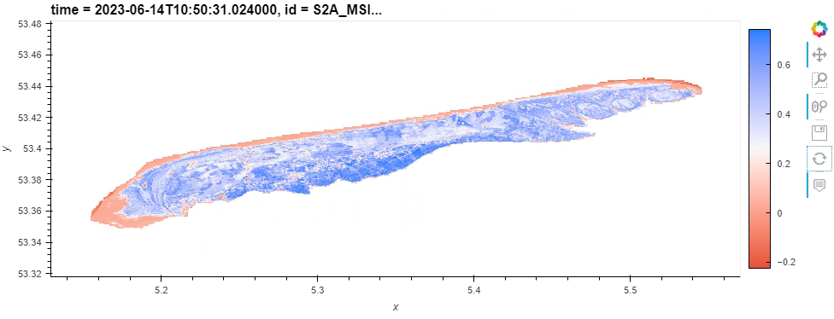
Exercise: Terschelling NDVI using CoCliCo & MPC STAC
Assess vegetation dynamics for one full year on the island of Terschelling, The Netherlands.
Datasets:
Coastal Mask (CoCliCo) → Mask
S2-L2A (MPC) → NDVI

